Slide 1
Operating Systems Tutorial
Amit Dua
Computer Science and Information Systems Department
BITS, Pilani

Slide 2
Unix File System
Tutorial 5
Slides taken from the ones prepared by Dr. Mayuri Digalwar

Slide 3
OPEN system call
Syntax is
fd = open(pathname,flags,modes);
int open(const char *path, int flags, mode_t mode);
int open(const char *path, int flags);
where,
pathname is the file name
flags indicate type of file (reading/writing)
modes gives the file permission (if file is created)
Returns an integer called file descriptor
Rest of the system calls make use of this file descriptor.

Slide 4
Example on open()
Mayuri@localhost myopen]$ ./exam1 t2.txt
Error opening file
[Mayuri@localhost myopen]$ ./exam1 t1.txt
file opened successfully
fd1=3
int main(int argc, char *argv[])
{
int fd1,fd2;
fd1 = open(argv[1],O_RDONLY);
if(fd1 == -1){
printf("Error opening file \n");
exit(0);
}
printf("file opened successfully\n");
printf("fd1=%d\n",fd1);
}

Slide 5
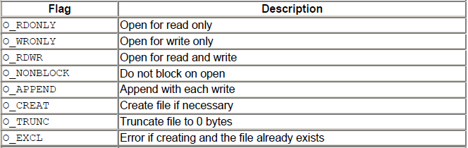
Different flags values

Slide 6
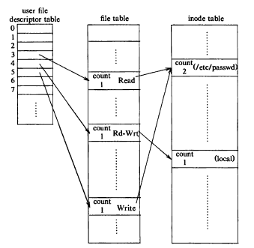


Slide 7
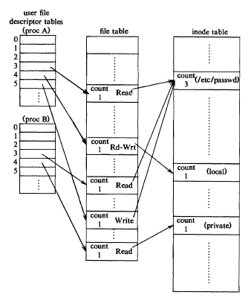

Slide 8
creat() system call
Syntax is
fd = creat(pathname,mode)
int creat(const char *path, mode_t mode);
modes-: permissions
flags : O_WRONLY|O_CREAT|O_TRUNC always same constant value, so no need to mention

Slide 9
Close ()
int close( int fd); /*file descriptor */
/* Returns 0 on success and -1 on error */
It makes the file descriptor available for re-use.
It does not flush any kernel buffers or perform any other clean-up task.

Slide 10
read() system call
size_t read(int fd, void *buf, size_t nbytes);
size_t write(int fd, void *buf, size_t nbytes);
fd – file descriptor
buf – buffer to hold data after read
nbytes – number of bytes to be read
Both functions return number of bytes read/written and returns -1 on error.

Slide 11
Write system call
#include<sys/types.h>
# include<unistd.h>
ssize_t write(
int fd, /* open file descriptor on which to write*/
const void *buf, /*data to write*/
ssize_t nbytes /*amount to write*/
);
/* Returns the number of bytes written or -1 on error */

Slide 12
int main()
{
char buffer[128];
int nread;
nread = read(0,buffer,128); // reading data from STD_INPUT fd =0
printf("nread = %d\n",nread);
if(nread == -1)
write(2,"A read Error has occurred\n",26); //writing error to STD_ERR fd = 2
if((write(1,buffer,nread)) != nread) //writing data to STD_OUTPUT fd = 1
write(2,"write error has occurred\n",25);
exit(0);
}
read & write system calls

Slide 13
lseek() system call
It sets the read/write pointer of a file descriptor which it can use for next read/write
off_t lseek(int fd, off_t offset, int reference);
offset is used to specify the position
reference is used by the offset
SEEK_SET – offset is absolute position
SEEK_CUR – offset is relative to the current position
SEEK_END – offset is relative to the end of the file

Slide 14
int main(int argc,char * argv[])
{
int fd1,sekval,nread;
char c,buf[20];
fd1 = open(argv[1],O_RDONLY);
if(fd1 == -1)
{
printf("Error opening file\n");
exit(0);
}
if((nread=read(fd1,&c,1))==1)
{
printf("%c\n",c);
sekval = lseek(fd1,10,SEEK_CUR);// next seek value = 11
}
read(fd1,&c,1);
printf("%c\n",c);
close(fd1); }
lseek()
[Mayuri@localhost myopen]$ ./a.out t1.txt
i
n
[Mayuri@localhost myopen]$

Slide 15
Lseek() file t1.txt
introduction to computing systems from bits and gates to C and beyond Birla institute of technology and science, pilani (rajasthan)

Slide 16
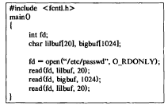

Slide 17
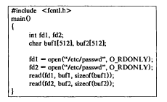

Slide 18
Close ()
#include <stdio.h>
#include <fcntl.h>
#include <unistd.h>
#include <sys/stat.h>
int main()
{
int fd1, ret;
fd1 = open(“txt1.txt”, O_RDONLY | O_CREAT, 0777);
ret = close(fd1);
printf(“\n Result:%d”, ret);
}

Slide 19
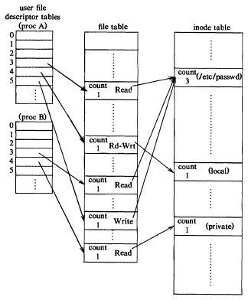
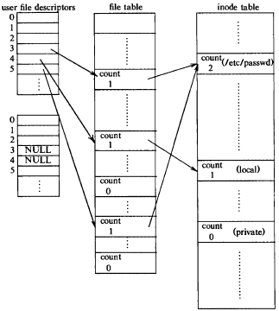

Slide 20
read() system call
int main (int argc, char *argv[])
{
char buff[10];
int ret,fd1;
fd1 = open(“txt1.txt”, O_RDONLY | O_CREAT, 0777);
ret = read(fd1, buff, 10);
printf(“%s\n”,buff);
return 0;
}

Slide 21
write system call
#include <stdio.h>
#include <fcntl.h>
#include <unistd.h>
int main()
{
char buffer[12] = “I LOVE BITS”
int fd1, ret;
fd1 = creat(“txt1.txt”, 0777);
ret = write(fd1, buffer, sizeof(buffer));
return 0;
}

Slide 22
read & write system calls
int main()
{char buffer[128];
int nread;
nread = read(0,buffer,128); // reading data from STD_INPUT fd =0
printf("nread = %d\n",nread);
if(nread == -1)
write(2,"A read Error has occurred\n",26); //writing error to STD_ERR fd = 2
if((write(1,buffer,nread)) != nread) //writing data to STD_OUTPUT fd = 1
write(2,"write error has occurred\n",25);
exit(0);}

Slide 23
lseek() system call
It sets the read/write pointer of a file descriptor which it can use for next read/write.
off_t lseek(int fd, off_t offset, int reference);
offset is used to specify the position
reference is used by the offset
SEEK_SET – offset is absolute position
SEEK_CUR – offset is relative to the current position
SEEK_END – offset is relative to the end of the file

Slide 24
lseek() system call
Testfile.txt
This is a text file that will be used to demonstrate the use of lseek.
Output: This is a text file
text file that will
#include <unistd.h>
#include <fcntl.h>
#include <sys/types.h>
int main()
{ int file;
if((file=open("testfile.txt",O_RDONLY)) < 0)
return -1;
char buffer[19];
if(read(file,buffer,19) != 19) return -1;
printf("%s\n",buffer);
if(lseek(file,10,SEEK_SET) < 0) return -1;
if(read(file,buffer,19) != 19) return -1;
printf("%s\n",buffer);
return 0;}

Slide 25
lseek()
int main(int argc,char * argv[])
{
int fd1,sekval,nread;
char c,buf[20];
fd1 = open(argv[1],O_RDONLY);
if(fd1 == -1)
{
printf("Error opening file\n");
exit(0);
}
if((nread=read(fd1,&c,1))==1)
{
printf("%c\n",c);
sekval = lseek(fd1,10,SEEK_CUR);
}
read(fd1,&c,1);
printf("%c\n",c);
close(fd1); }
[shashank@localhost myopen]$ ./a.out t1.txt
i
n
[shashank@localhost myopen]$
t1.txt
introduction

Slide 26
dup() system call
The dup() system call creates a copy of the file descriptor oldfd, using the lowest-numbered unused file descriptor for the new descriptor.
Syntax: int dup(int oldfd);
Return Value: On success, these system calls return the new file descriptor. On error, -1 is returned.

Slide 27
dup() system call
#include<stdio.h>
#include <unistd.h>
#include <fcntl.h>
int main()
{
int file_desc = open("dup.txt", O_WRONLY | O_APPEND);
if(file_desc < 0)
printf("Error opening the file\n");
int copy_desc = dup(file_desc);
write(copy_desc,"This will be output to the file named dup.txt\n", 46);
write(file_desc,"This will also be output to the file named dup.txt\n", 51);
return 0;
}

Slide 28
dup2() system call
The dup2() system call performs the same task as dup(), but instead of using the lowest-numbered unused file descriptor, it uses the file descriptor number specified in newfd. If the file descriptor newfd was previously open, it is silently closed before being reused.
Syntax: int dup2(int oldfd, int newfd);
Return Value: On success, these system calls return the new file descriptor. On error, -1 is returned.

Slide 29
dup2() system call
#include<stdlib.h>
#include<unistd.h>
#include<stdio.h>
#include<fcntl.h>
int main()
{
int file_desc = open("tricky.txt",O_WRONLY | O_APPEND);
dup2(file_desc, 1) ;
printf("I will be printed in the file tricky.txt\n");
return 0;
}

Slide 30
dup() and dup2() system call
#include<stdlib.h>
#include<unistd.h>
#include<fcntl.h>
int main()
{
int fd1, fd2;
fd1 = open(“txt1.txt”, O_RDONLY | O_CREAT, 777);
close(2);
dup(fd1);
}

Slide 31
dup() and dup2() system call
#include<stdlib.h>
#include<unistd.h>
#include<fcntl.h>
int main()
{
int fd1, fd2, fd3;
fd1 = open(“txt1.txt”, O_RDONLY | O_CREAT, 777); //3
fd2 = open(“txt2.txt”, O_RDONLY | O_CREAT, 777); //4
//close (fd2);
fd3=dup2(fd1, fd2);
}

Slide 32
chmod system call
The chmod command is used to change the access mode of a file.
Syntax: chmod [reference][operator][mode] filename
The references are used to distinguish the users to whom the permissions apply i.e. they are list of letters that specifies whom to give permissions.
Reference Class
u owner
g group
o others
a all

Slide 33
chmod system call
The operator is used to specify how the modes of a file should be adjusted. The following operators are accepted:
Operator Description
+ Adds the specified modes to the specified classes.
- Removes the specified modes from the specified classes.
= The modes specified are to be made the exact modes for the specified classes.

Slide 34
chmod system call
The modes indicate which permissions are to be granted or removed from the specified classes. There are three basic modes which correspond to the basic permissions:
Mode Description
r Permission to read the file.
w Permission to write (or delete) the file.
x Permission to execute the file, or, in the case of a directory, search it.

Slide 35
chmod system call
- rw- rw- r-- shashank shashank text1.c
- rw- rw- r-- shashank shashank text2.c
d rwx rwx r-x shashank shashank BITS
- rw- rw- r-- shashank shashank semaphore.c
rwx r-x r-x shashank shashank xyz.c
BEFORE: - rw- rw- r-- shashank shashank text1.c
COMMAND: chmod u=r text1.c
AFTER: - r-- rw- r-- shashank shashank text1.c

Slide 36
chmod system call
Let’s restrict the permission such that the user cannot search the directory BITS.
- r-- rw- r-- shashank shashank text1.c
- rw- rw- r-- shashank shashank text2.c
d rwx rwx r-x shashank shashank BITS
- rw- rw- r-- shashank shashank semaphore.c
rwx r-x r-x shashank shashank xyz.c
BEFORE: drwxrwxr-x shashank shashank BITS
COMMAND: chmod u=rw BITS
AFTER: drw-rwxr-x shashank shashank BITS

Slide 37
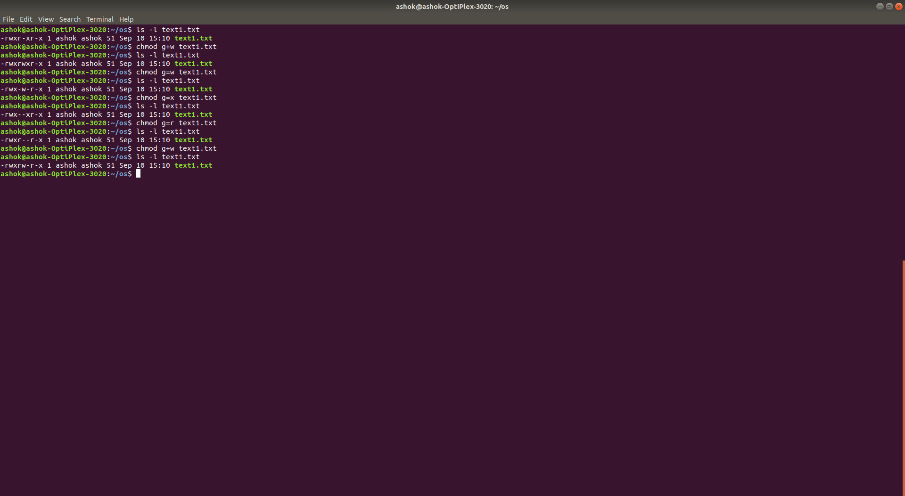
Example:

Slide 38
chown system call
The chown command changes the user and/or group ownership of for given file..
Syntax
chown owner-user file
chown owner-user:owner-group file
chown owner-user:owner-group directory

Slide 39
chown system call
First, list permissions for demo.txt, enter:
ls -l demo.txt
Sample outputs: -rw-r--r-- 1 root root 0 Aug 31 05:48 demo.txt
In this example change file ownership to vivek user and list the permissions, run:
chown vivek demo.txt
ls -l demo.txt
Sample outputs:
-rw-r--r-- 1 vivek root 0 Aug 31 05:48 demo.txt

Slide 40
chown system call
Now, the owner is set to vivek followed by a colon and a group ownership is also set to vivek group, run:
chown vivek:vivek demo.txt
ls -l demo.txt
Sample outputs:-rw-r--r-- 1 vivek vivek 0 Aug 31 05:48 demo.txt

Slide 41
chown system call
Here, we have changed only the group of file. To do so, the colon and following GROUP-name ftp are given, but the owner is omitted, only the group of the files is changed:
chown :ftp demo.txt
ls -l demo.txt
Sample outputs:
-rw-r--r-- 1 vivek ftp 0 Aug 31 05:48 demo.txt

Slide 42
Directory System Calls
getcwd()
mkdir()
chdir()
rmdir()
opendir()
closedir()
readdir()

Slide 43
getcwd System Call
To get the current working directory in UNIX, we use the “pwd” command.
The system call behind the “pwd” command is the getcwd() call.
# include<unistd.h>
char *getcwd(
char *buf, /* Returned pathname */
size_t bufsize /* sizeof buf */
);
/* Returns pointer to 'buf' on success and NULL on error */
bufsize is the maximum size of path. Following system call can be used to get maximum size of path.
long max= pathconf(“/”,_PC_PATH_MAX);

Slide 44
A program that uses the getcwd()
# include<stdio.h>
# include<unistd.h>
int main(void) {
long max;
char *buf;
max= pathconf(“/”,_PC_PATH_MAX);
buf=(char*)malloc(max);
getcwd(buf,max);
printf(“%s\n”,buf);
return 0;
}

Slide 45
chdir System Call(cd command in Unix)
# include<unistd.h>
int chdir(
const char *path;
);
/* Returns 0 on success and -1 on error */
This system call changes the current working directory to that specified in “path”.

Slide 46
Make and remove dir System Call
# include<sys/stat.h>
int mkdir(
const char *path, /* Pathname */
mode_t perms /* Permissions */
);
/* Returns 0 on success and -1 on error */
int rmdir(
const char *path /* Pathname */
);
/* Returns 0 on success and -1 on error */

Slide 47
Program to make and remove directory
int main(int argc,char *argv[])
{ int md,rd;
DIR *ds;
struct dirent *dir;
md = mkdir(argv[1],0777);
if(md == 0)
printf("%s directory is created\n",argv[1]);
else
printf("%s directory is not created\n",argv[1]);
rd = rmdir(argv[2]);
if(rd == 0)
printf("%s directory is removed\n",argv[2]);
else
printf("%s directory is not removed\n",argv[2]);
}

Slide 48
opendir and closedir System Calls
# include<dirent.h>
DIR* opendir(
const char *path /* directory pathname */
);
/* Returns a DIR pointer or NULL on error */
# include<dirent.h>
int closedir(
DIR *dirp /*DIR pointer from opendir */
);
/* Returns a 0 on success or -1 on error */

Slide 49
readdir System Call and dirent structure
#include <dirent.h>
struct dirent *readdir(
DIR *dirp /* DIR Pointer from opendir */
);
/* Returns structure or NULL on EOF or error */
struct dirent {
ino_t d_ino; /* i-number */
char d_name[]; /* name */
};

Slide 50
int main(int argc,char *argv[])
{
DIR *ds; struct dirent *dir;
ds = opendir(argv[1]);
if(ds == NULL)
printf("directory %s is not opened\n",argv[1]);
else
printf("ds = %ld\n",ds);
printf("list of files and directories\n");
while((dir = readdir(ds)) != NULL)
printf("%s\n",dir->d_name);
if((cld = closedir(ds)) == 0)
printf("%s is successfully closed\n",argv[1]);
else
printf("%s is not successfully closed\n",argv[1]);
}
[Mayuri@localhost dirProgs]$ ./a.out /home/Mayuri/Downloads/
open the directory
ds = 9236496
list of files and directories
..
.
SimplescalarHowto.pdf
Installation_Guide_for_SimpleScalar.pdf
p130-spradling.pdf
/home/Mayuri/Downloads/ is successfully closed
[Mayuri@localhost dirProgs]$

Slide 51
program to display the detailed directory structure (output)
mayuri@atlas:~$ ./a.out dsa
Directory scan of dsa
lab1/
SortedSeqList.h
greedyAlgos/
a.out
coinset.c
IntervalScheduling/
a.out
dataDef.h
output.txt
schOps.h
input.txt
main.c
schedulingOps.c
schedulingOps.o
**************DONE************
mayuri@atlas:~$

Slide 52
Programming Exercise
Write a program to make a directory, create two text files inside it, open the directory and file. Write to one of the files and then copy content of one file to another. Close the files and the directory.

Slide 53
Thank You

